Slide 1
Frequent Pattern Growth Algorithm

Slide 2
Outline
What is Frequent Pattern Growth Algorithm?
FP Growth Algorithm Example

Slide 3
FP-Growth Algorithm
The FP-growth (Frequent Pattern growth) algorithm is a popular algorithm for discovering frequent itemsets and association rules.
It offers advantages over both Apriori and Eclat in terms of efficiency and scalability.
The FP-growth algorithm employs a divide-and-conquer strategy to discover frequent itemsets.

Slide 4
FP-Growth Algorithm
It constructs a tree-like data structure known as the (Frequent Pattern tree) from the transaction database.
This tree structure compactly represents the frequent patterns and their support counts.
FP-growth then recursively mines the tree to find frequent itemsets.
Unlike Apriori, FP-growth does not generate candidate itemsets explicitly, which makes it faster and more memory-efficient, especially for large datasets.

Slide 5
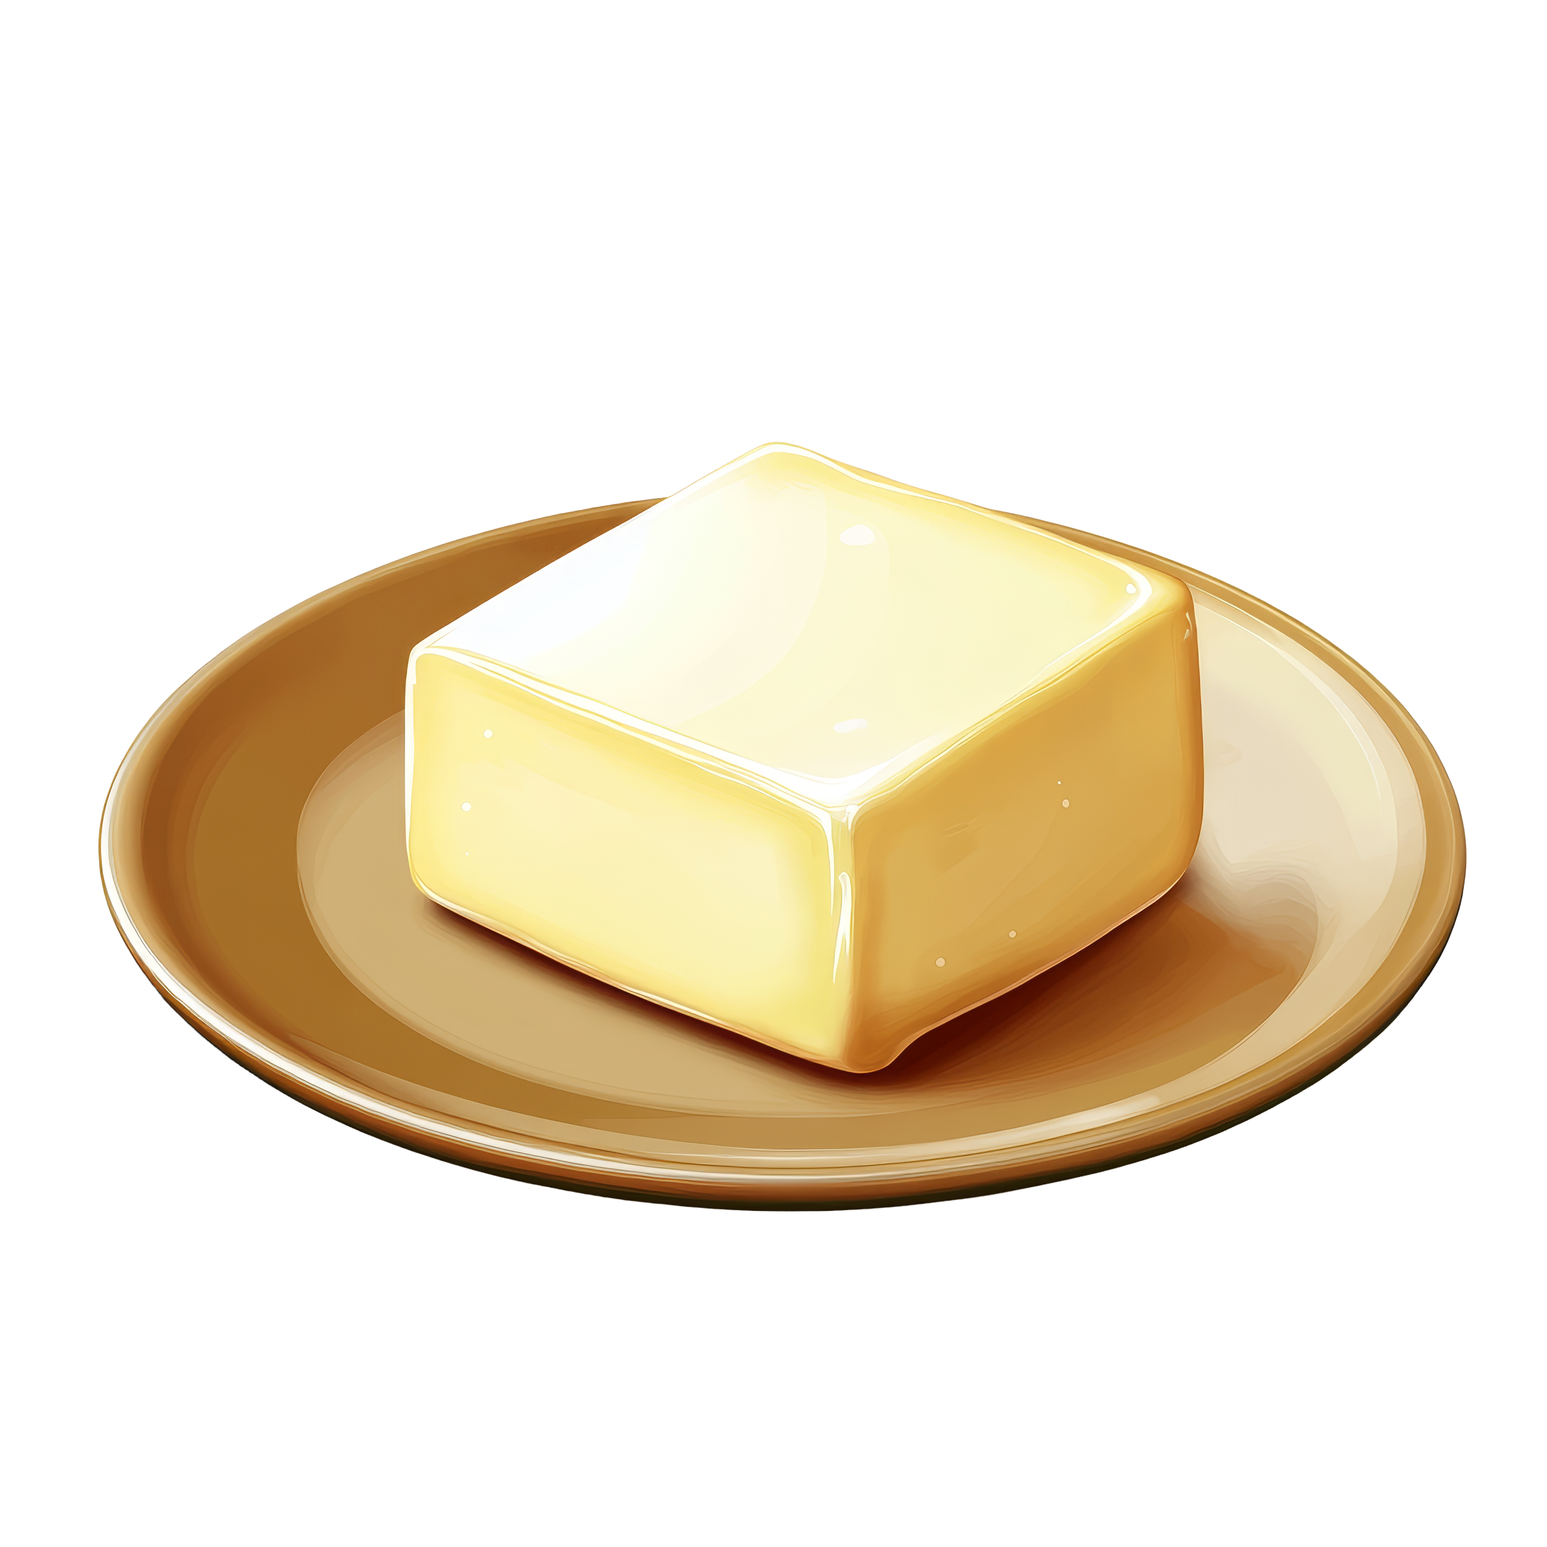
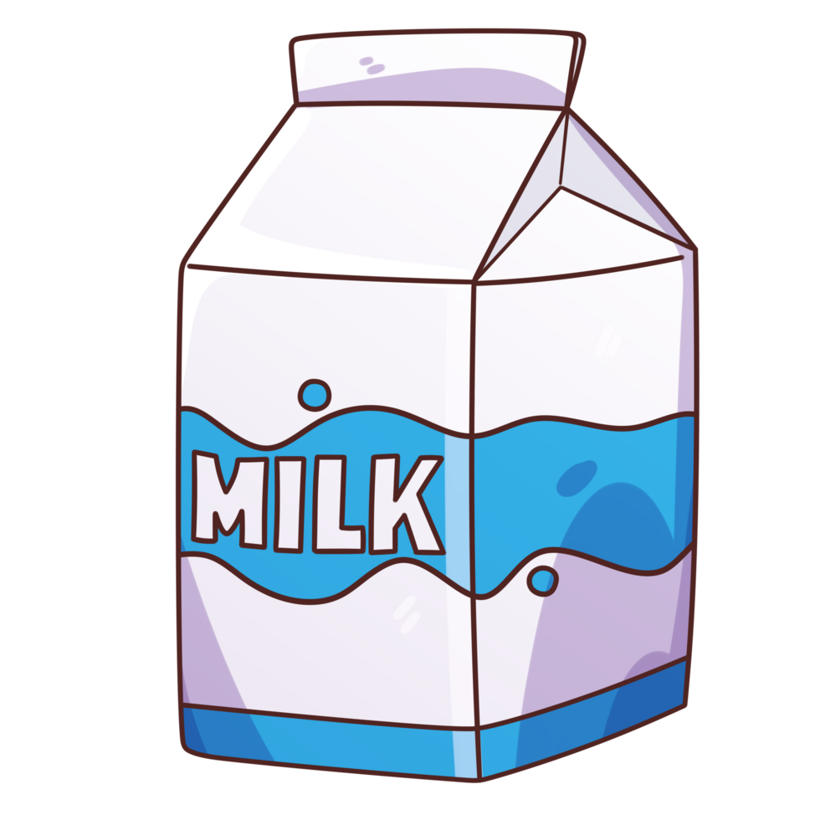
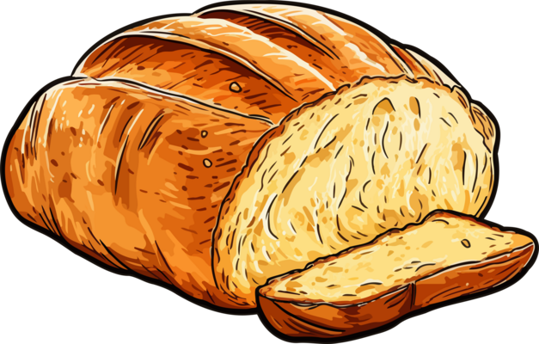
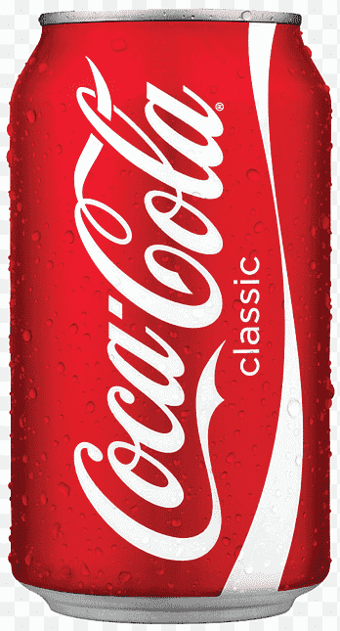
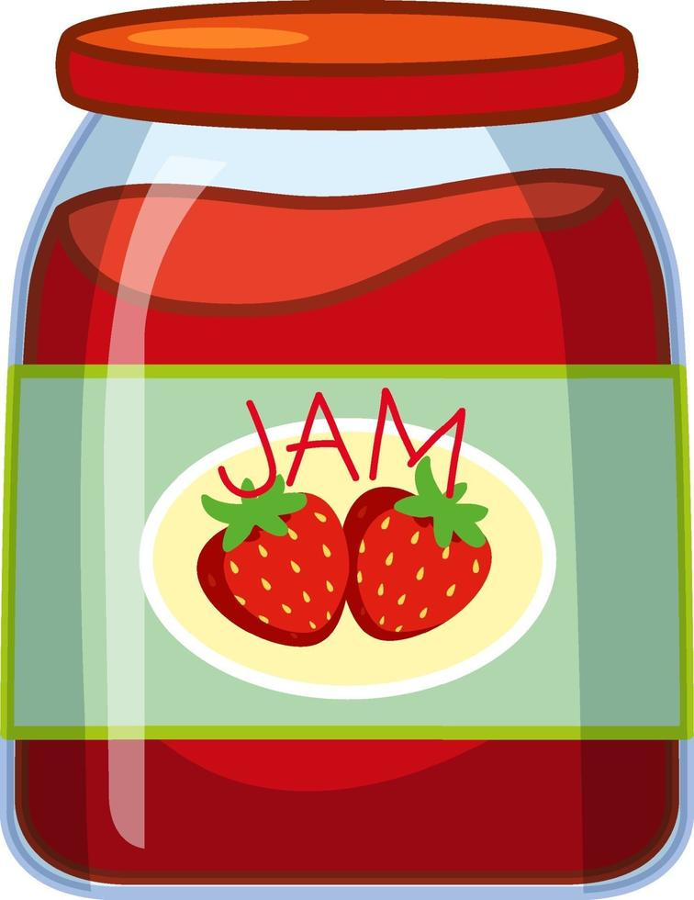
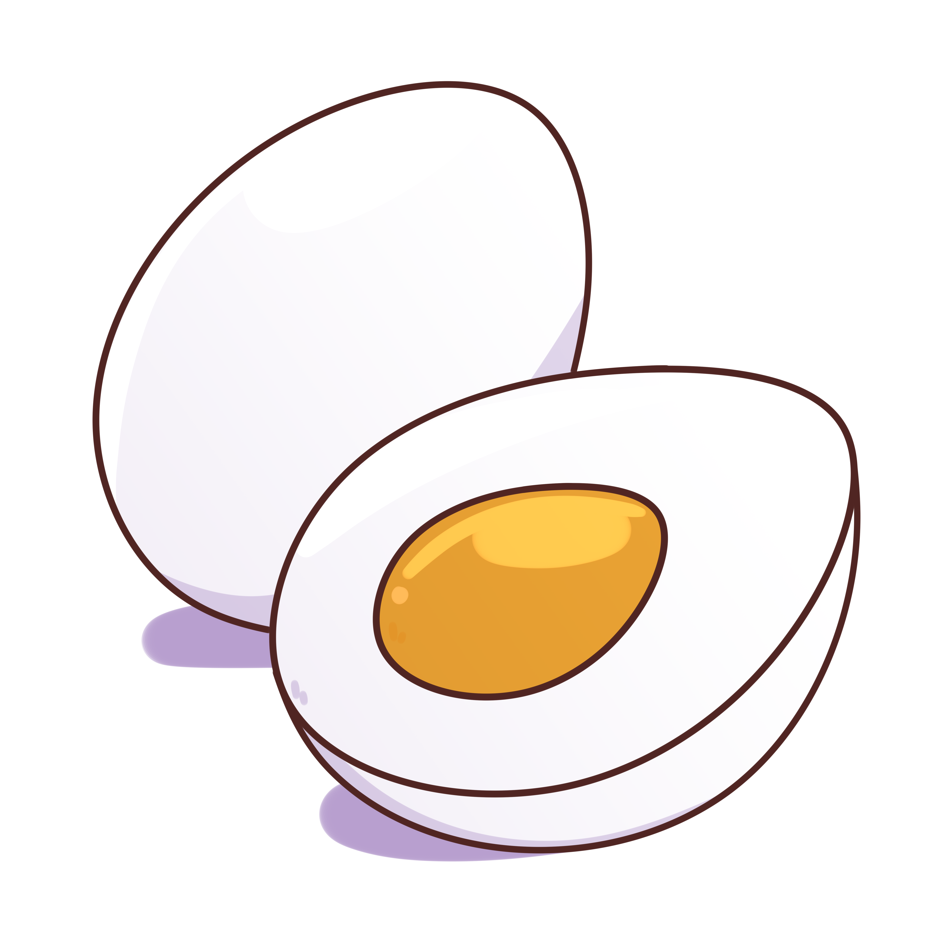
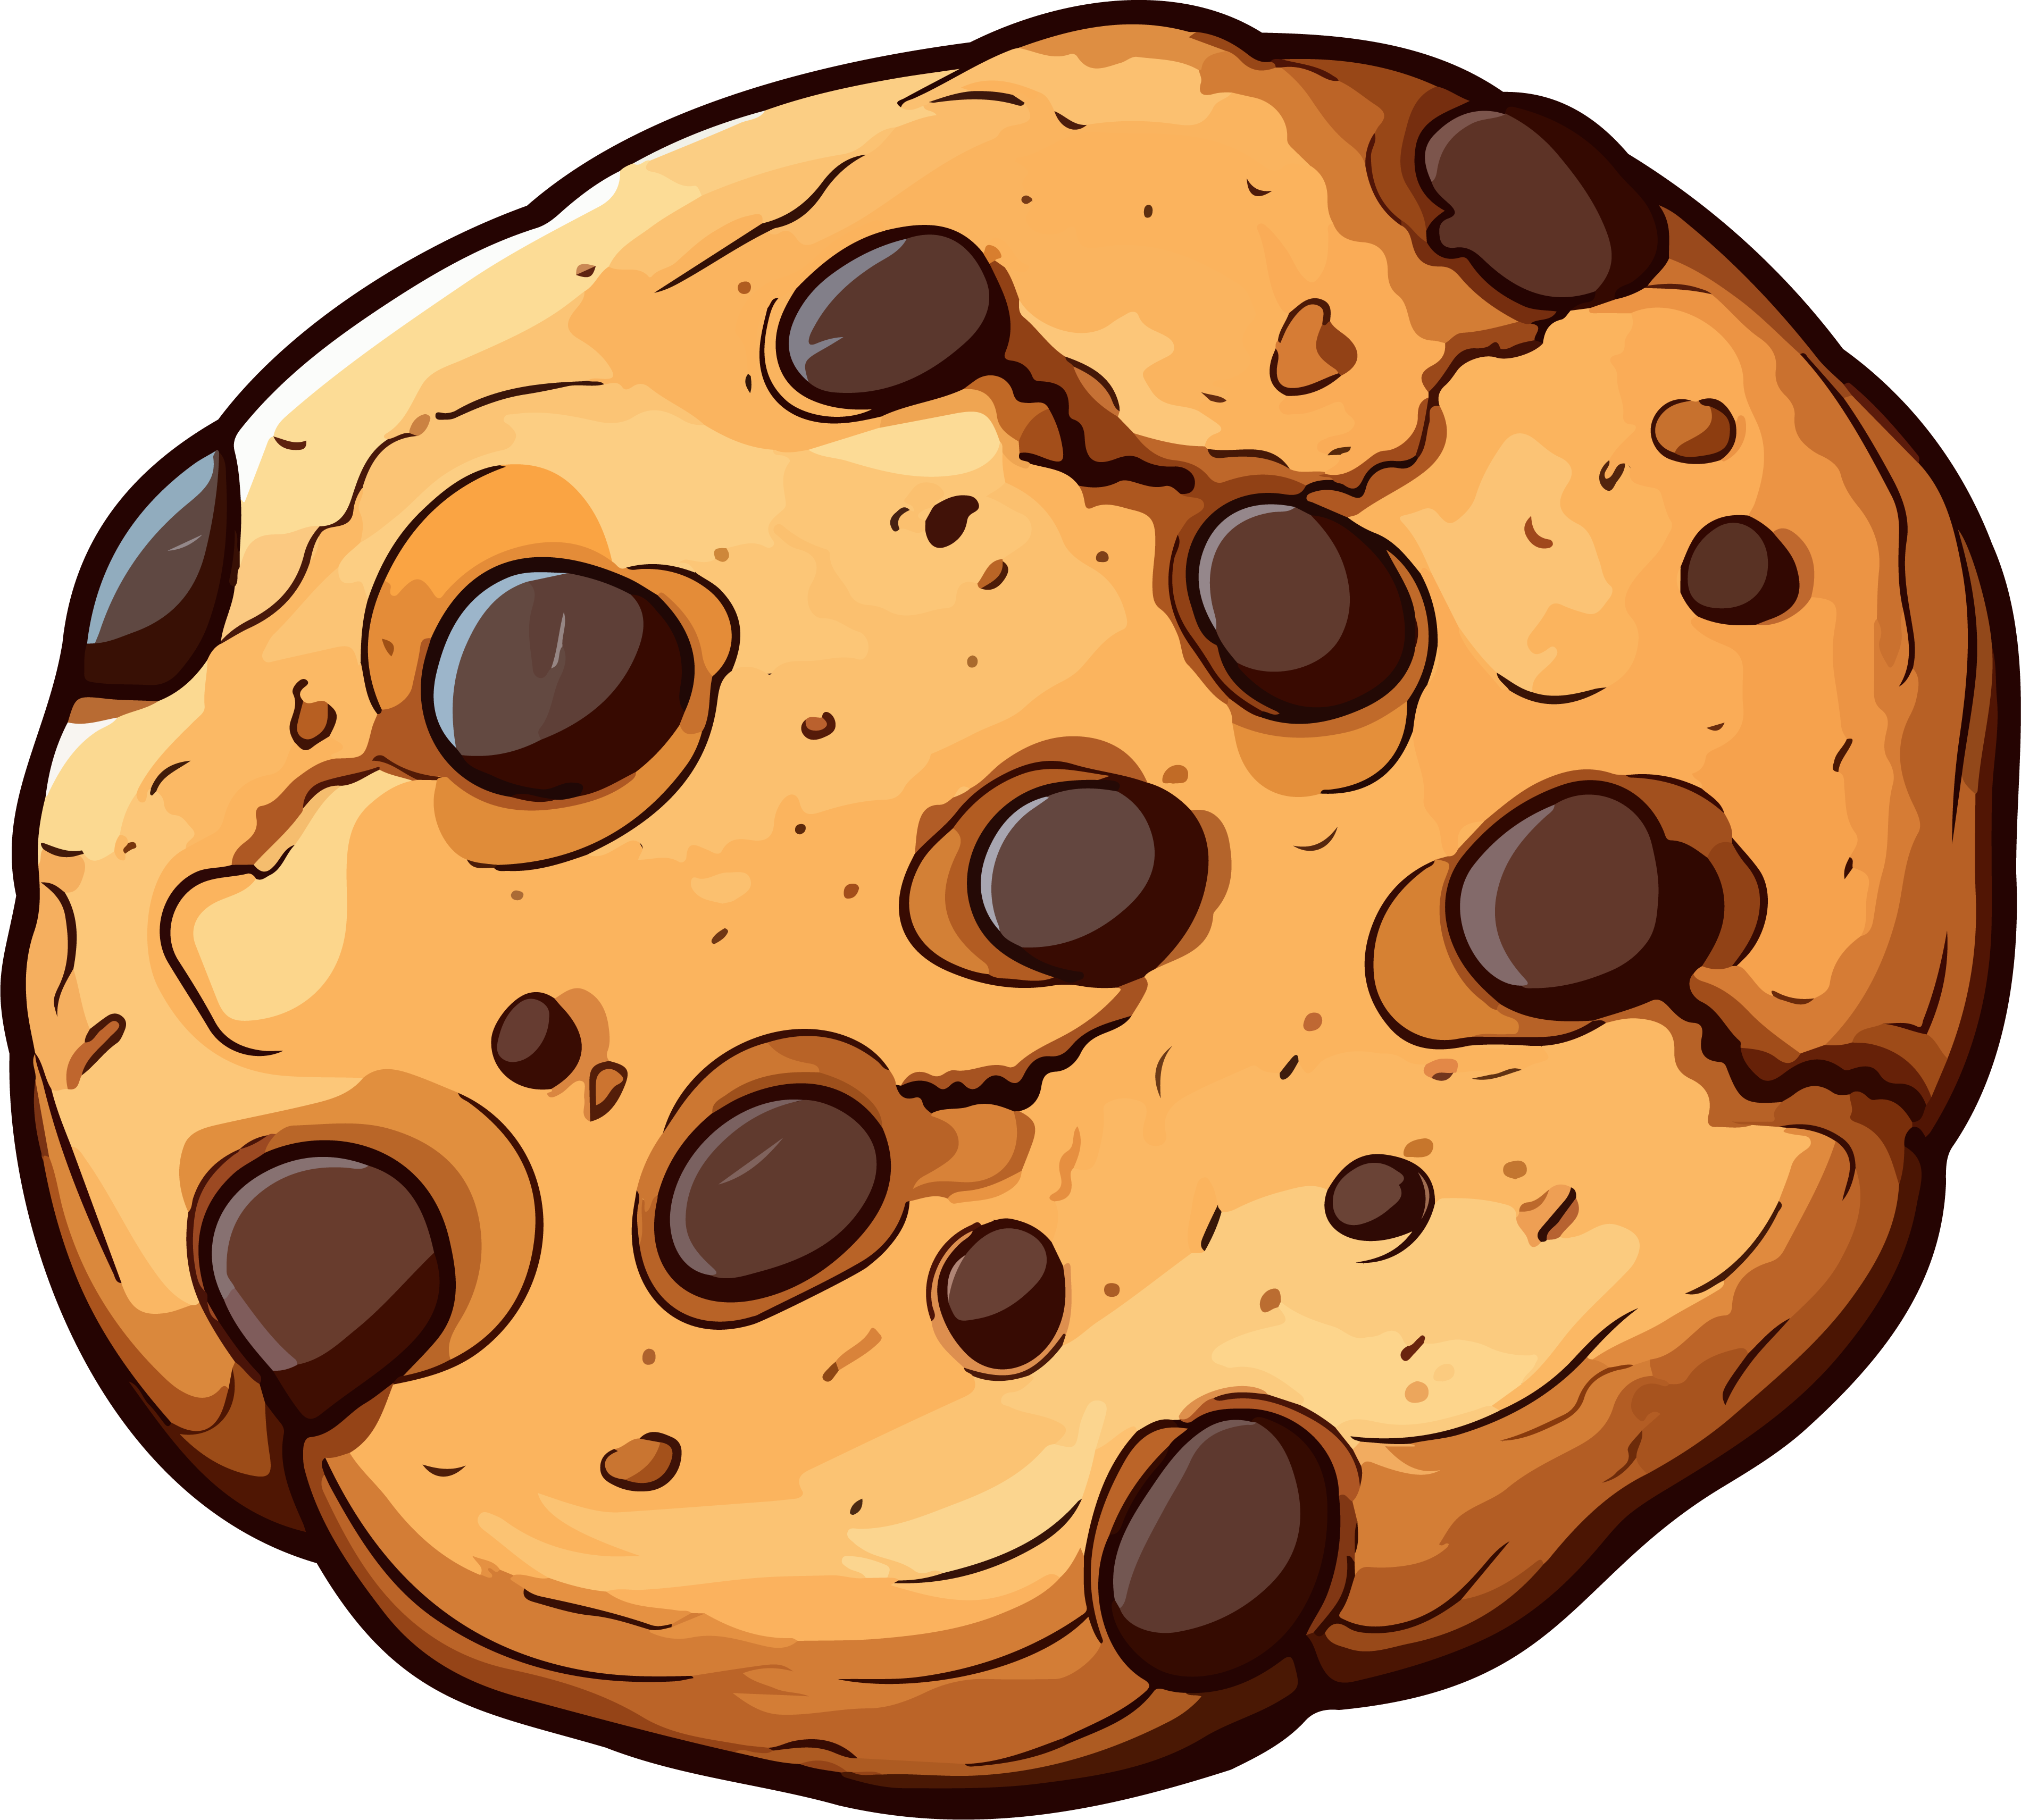




Transaction ID | Items
1
2
3
4
5

Slide 6
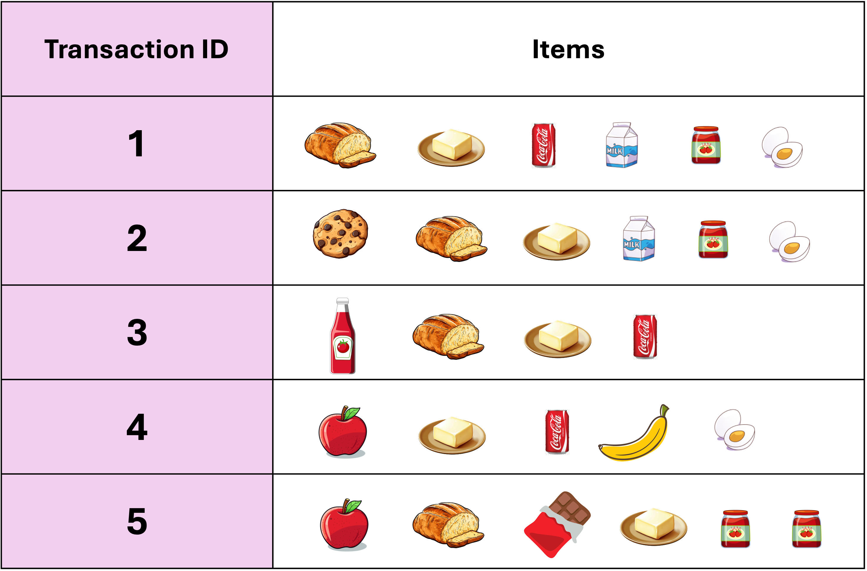
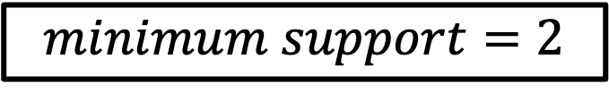
$$minimum support=2$$
Item set | Frequency
 | 4
 | 5
 | 3
 | 2
 | 3
 | 3
 | 1
 | 1
 | 2
 | 1
 | 1

Slide 7
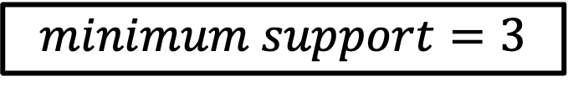

Item set | Frequency
 | 4
 | 5
 | 3
 | 2
 | 3
 | 3
 | 1
 | 1
 | 2
 | 1
 | 1
$$minimum support=3$$
Frequent Pattern Set is built which will contain all the elements whose frequency is greater than or equal to the minimum support
These elements are stored in descending order of their respective frequencies.
$$L=\{Butter:5, Bread:4,Jam:3,Egg:3,Coke:3,\}$$

Slide 8

Next, for each transaction, the respective Ordered-Item set is built
$$L=\{Butter:5, Bread:4,Jam:3,Egg:3,Coke:3,\}$$
Transaction ID | Items | Ordered Items
1
2
3
4
5

Slide 9
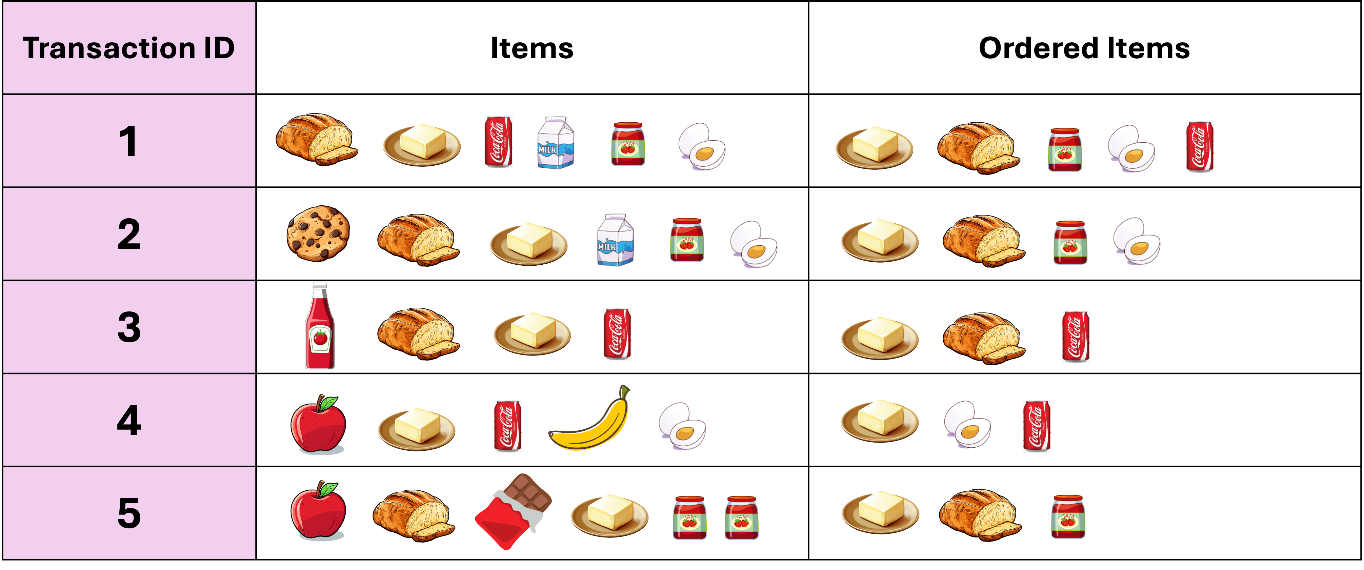
Next, all the Ordered-Item set are represented into a Tree Data Structure
1
1
1
1
1

Slide 10
Next, all the Ordered-Item set are represented into a Tree Data Structure
2
2
2
2
1

Slide 11
Next, all the Ordered-Item set are represented into a Tree Data Structure
3
3
2
2
1
1

Slide 12
Next, all the Ordered-Item set are represented into a Tree Data Structure
4
3
2
2
1
1
1
1

Slide 13
Next, all the Ordered-Item set are represented into a Tree Data Structure
5
4
3
2
1
1
1
1

Slide 14
Next, for each item, the Conditional Pattern Base is computed which is the path labels of all the paths which lead to any node of the given item in the frequent pattern tree
Items | Conditional Pattern Base
 | {Butter, Bread,Jam, Egg: 1}, {Butter,Bread: 1}, {Butter, Egg: 1}
 | {Butter, Bread, Jam: 2}, {Butter: 1}
 | {Butter, Bread: 3}
 | {Butter: 4}
5
4
3
2
1
1
1
1

Slide 15
Next, for each item the Conditional Frequent Pattern Tree is built. It is done by taking the set of elements which is common in all the paths in the Conditional Pattern Base of that item and calculating its support count by summing the support counts of all paths in the Conditional Pattern Base
Items | Conditional Pattern Base | Conditional Frequent Pattern Tree
 | {Butter, Bread,Jam, Egg: 1}, {Butter,Bread: 1}, {Butter, Egg: 1} | {Butter: 3}
 | {Butter, Bread, Jam: 2}, {Butter: 1} | {Butter: 3}
 | {Butter, Bread: 3} | {Butter, Bread: 3}
 | {Butter: 4} | {Butter: 4}

Slide 16
From the Conditional Frequent Pattern Tree, the Frequent Pattern Rules are generated by pairing the items of the Conditional Frequent Pattern Tree set to the corresponding to the item as given in the table.
Items | Conditional Pattern Base | Conditional Frequent Pattern Tree
 | {Butter, Bread,Jam, Egg: 1}, {Butter,Bread: 1}, {Butter, Egg: 1} | {Butter: 3}
 | {Butter, Bread, Jam: 2}, {Butter: 1} | {Butter: 3}
 | {Butter, Bread: 3} | {Butter, Bread: 3}
 | {Butter: 4} | {Butter: 4}
Items | Frequent Pattern Generated
 | Butter, Coke: 3
 | Butter, Egg: 3
 | Butter, Jam: 3, Bread, Jam: 3, Butter, Bread, Jam: 3
 | Butter, Bread: 4

